Slide 1
Physics 2 – Jan 31, 2020
Get out p125 #1-12 for
HMK check
P3 Challenge – When a 350. g sample of an unknown metal at 85.0C is dropped into 480. g of water initially at 20.0C, the temperature of the water rises to 24.8C. What is the heat capacity of the metal? What is the likely identity of the metal?

Slide 2
Physics 2 – Jan 31, 2020
Today’s Objective:
3.1 Thermal Physics; Calorimetry
Assignment:
Extra Calorimetry Worksheet
Agenda
Calorimetry
Homework Review
Time to work together on Extra Calorimetry WS for Answer alignment on WBs

Slide 3
Homework Answers
1. a) Yes, Q_{C}= - Q_{H} . Energy is conserved for the system. B) T_{C} = - T_{H} only if the same material. Generally, the two T are probably different due to specific heat capacity differences.
2. a) 513 J/kgC b) same
3. 2.78 J/gC or 2780 J/kgK
4. 4.16 J/gC or 4160 J/kgK
5. 71.7 C or 72 K
6. a) 116 kJ/K b) 86.3 min
7. 34.9 g (watch units!!)
8. 3.73 x 10⁸J or 373, 000 kJ
9. a) 83.5 min b) Assume no reflection of light energy from the ice.
10. a) 22 kJ b) 334 kJ c) 41.8 kJ d) melting needs the most energy
11. 0.111 kg or 111 g
12. Hint: Assume the final temperature will be greater than 30C because of the large value of L_{v}. 95.1C

Slide 4
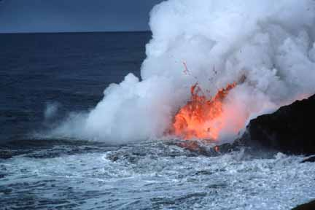
Extra Calorimetry Problems Answers only
1. 900 J/kgK Al
2. 42.9 kJ
3. 23.5C
4. 87.1 kJ
5. 52.8 kJ
6. 647 g
7. 109 J/kgK
8. 17.4 kg
9. 57.5C
10. 51.1C
11. 29.1 kg

Slide 5
General Problem solving approach
Draw picture. Label hot and cold parts to determine flow of energy.
Create a calorimetry equation.
For amount of energy lost by hot items Q_{H} = amount of energy gained by cold items. Q_{c} $\left|Q_{H}\right|=\left|Q_{c}\right|$ You can use this format when you know all temperatures involved.
Or recognizing that T for Q_{H} will be negative you use – Q_{H} = Q_{C} Anytime you use T_{f} – T_{i} for all heat calcs to solve for a temperature, you need to use this form.
Use mL or mcT or Pt or mgh or other way to calculate J for each part.
Substitute known values WITH UNITS. Change units as needed so they will cancel.
Drop the units and use just numbers for the equation to help solve.
Find your answer.

Slide 6
Tables

Slide 7
Exit Slip - Assignment
Exit Slip- a) How much energy does it take to evaporate 5.00 g of ethanol? B) Why is an alcohol rub away to cool a heat stroke victim or a fever?
What’s Due? (Pending assignments to complete.)
Extra calorimetry problems
What’s Next? (How to prepare for the next day)
Read 3.1 p116- 124 about Thermal Energy

